Slide 1
Ascend Global Co.
CORPORATE HOSPITALITY, EVENTS & RELOCATION
A thoughtful welcome
to work and life in the Upstate
Gifts, gatherings and settling-in support
ascendglobalco.com
Notes:
Ascend Global Co. serves corporate teams, individuals and families in Greenville–Spartanburg and surrounding Upstate South Carolina communities. International relocation means inbound settling-in support in the Upstate, not worldwide destination coverage. Project proposals confirm product selection, minimums, supplier availability, service hours, timing and costs. Rental items and other specialist services come from the appropriate providers.

Slide 2
Ascend Global Co.
02
Support for your people and occasions
Choose a single service or combine the details in one tailored proposal.
01 Gifts & branded merchandise
02 Corporate meetings & events
Gift boxes, apparel and useful essentials
for employees and clients.
Venue options, meals, schedules
and onsite coordination.
03 Event design & decoration
04 Rental coordination
A coordinated look for welcome areas,
tables and gathering spaces.
Furniture, linens and tabletop pieces
sourced through rental providers.
05 Relocation & settling-in
Area orientation and practical arrival support for domestic and international moves to the Upstate.
Notes:
Project proposals confirm product selection, minimums, supplier availability, service hours, timing and costs. Rental items and other specialist services come from the appropriate providers.

Slide 3

Ascend Global Co.
03
Corporate gifts
A welcome or thank-you,
chosen for your recipients.
Employee welcome
A notebook, drinkware, branded essential
and a personal welcome card.
Client & team appreciation
Specialty treats, useful keepsakes
and packaging that reflects your brand.
Illustrative gift concept. Contents and packaging can vary.
Notes:
Illustrative Ascend Global Co. concept. Final products, quantities, styling and services depend on the client brief and confirmed proposal. Possible occasions include onboarding, client appreciation, employee recognition and company milestones.
Visual: built-in image generation, not a photograph of a completed Ascend Global Co. project, actual client, confirmed partner, specific inventory item or available venue. Asset: gifting.jpg.

Slide 4

Ascend Global Co.
04
Apparel & branded essentials
Your brand on things
people can use
Polos, T-shirts and caps
Totes and bags
Notebooks and drinkware
Product selection, logo placement
and production timing follow
your approved brief.
Illustrative products. Available colors, decoration methods and order minimums vary by item.
Notes:
Illustrative Ascend Global Co. concept. Final products, quantities, styling and services depend on the client brief and confirmed proposal. The image uses a generic decorative emblem to illustrate a logo location. It is not a finalized logo or catalog of exact products.
Visual: built-in image generation, not a photograph of a completed Ascend Global Co. project, actual client, confirmed partner, specific inventory item or available venue. Asset: apparel.png.

Slide 5
Ascend Global Co.
05
Corporate meetings
& event planning
Offsites, client receptions, employee appreciation and holiday parties.
The place
The schedule
Venue research and comparisons
Room layout and audiovisual coordination
Vendor arrivals and event timing
Setup and onsite coordination
The food
The guest experience
Lunches, catering and refreshments
Dietary requests and meal timing
Invitations and welcome details
Optional gifts, décor and rental coordination
Notes:
Ascend Global Co. can research venues, coordinate meals and support event planning and onsite logistics. Food, venue, audiovisual and other services come from the appropriate providers. Project proposals confirm product selection, minimums, supplier availability, service hours, timing and costs. Rental items and other specialist services come from the appropriate providers.

Slide 6

Ascend Global Co.
06
Event design
& decoration
A welcoming space that reflects
your company and occasion.
The first impression
Welcome areas, signs and
branded displays.
The finishing details
Table styling, centerpieces,
color coordination and decorative accents.
Illustrative styling concept.
Notes:
Illustrative Ascend Global Co. concept. Final products, quantities, styling and services depend on the client brief and confirmed proposal. Design direction, setup and removal can form part of the agreed scope.
Visual: built-in image generation, not a photograph of a completed Ascend Global Co. project, actual client, confirmed partner, specific inventory item or available venue. Asset: styling.png.

Slide 7
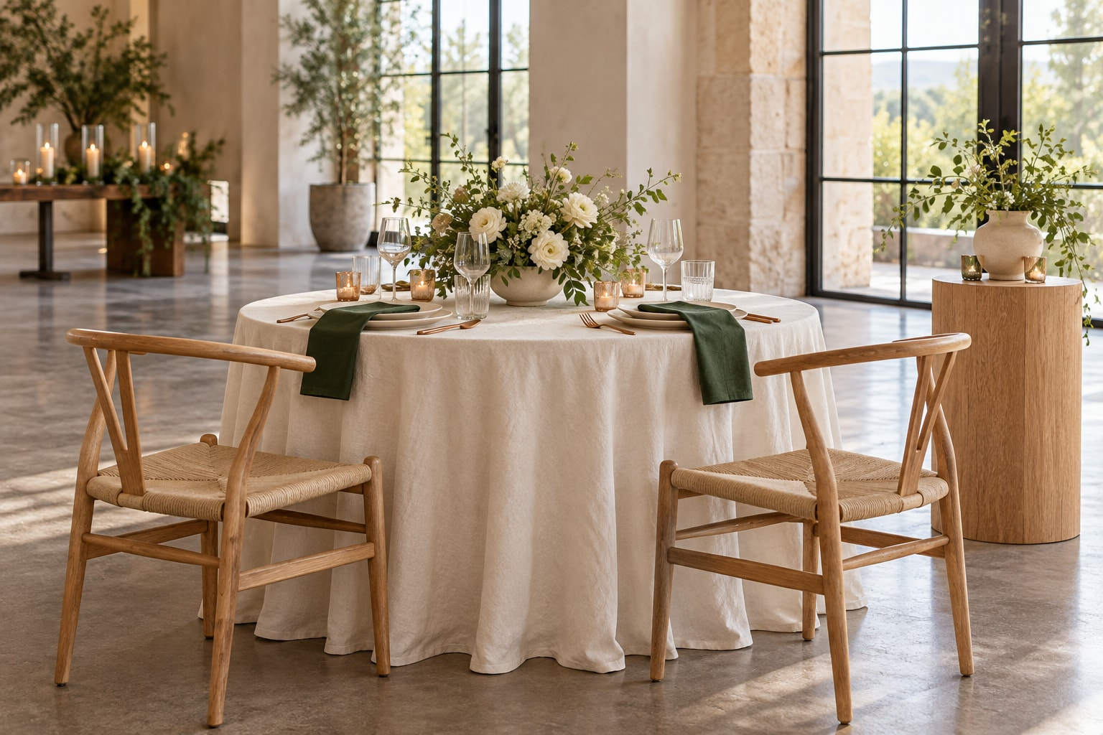
Ascend Global Co.
07
Rental sourcing & coordination
The pieces your
gathering needs
Tables and chairs
Linens and tabletop pieces
Display stands and décor
We source options through providers
and coordinate delivery, setup
and pickup as agreed.
Illustrative concept. Rental selection, availability, fees and responsibilities follow the confirmed proposal.
Notes:
Illustrative Ascend Global Co. concept. Final products, quantities, styling and services depend on the client brief and confirmed proposal. Ascend Global Co. sources and coordinates rental pieces through providers. No inventory ownership, confirmed supplier relationship or guaranteed availability is implied.
Visual: built-in image generation, not a photograph of a completed Ascend Global Co. project, actual client, confirmed partner, specific inventory item or available venue. Asset: rentals.png.

Slide 8

Ascend Global Co.
08
ILLUSTRATIVE SERVICE COMBINATION
Client appreciation
A personal thank-you
with considered details
Coffee or specialty treats
An everyday essential or keepsake
A personal message
Packaging and delivery coordination
Example concept. Local products can be explored where available. Final contents follow your brief.
Notes:
Illustrative Ascend Global Co. concept. Final products, quantities, styling and services depend on the client brief and confirmed proposal. The image illustrates a possible assortment, not a fixed-price package. Local maker products are subject to sourcing and availability.
Visual: built-in image generation, not a photograph of a completed Ascend Global Co. project, actual client, confirmed partner, specific inventory item or available venue. Asset: appreciation.png.

Slide 9
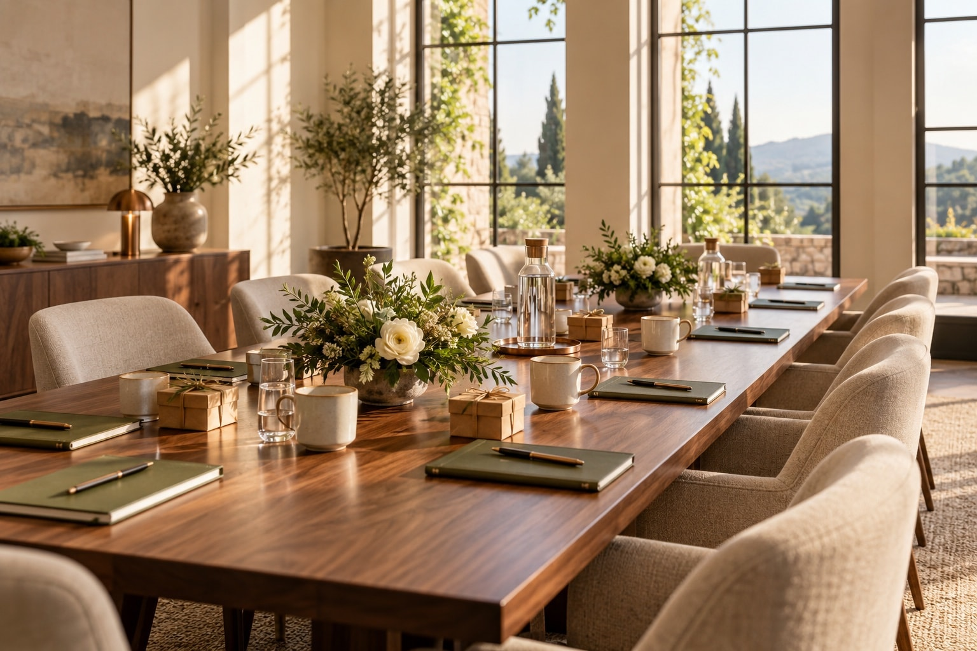
Ascend Global Co.
09
ILLUSTRATIVE SERVICE COMBINATION
A team offsite
Venue research, lunch arrangements
and a clear plan for the day.
09:00 Arrival and coffee
09:30 Team meeting
12:00 Working lunch
13:00 Breakout session
15:00 Wrap-up
Example schedule and venue concept. Room setup, welcome gifts and onsite support can be added to the brief.
Notes:
Illustrative Ascend Global Co. concept. Final products, quantities, styling and services depend on the client brief and confirmed proposal. This fictional schedule shows how venue, food and timing can fit together. It does not represent a booked or partner venue.
Visual: built-in image generation, not a photograph of a completed Ascend Global Co. project, actual client, confirmed partner, specific inventory item or available venue. Asset: meeting.jpg.

Slide 10
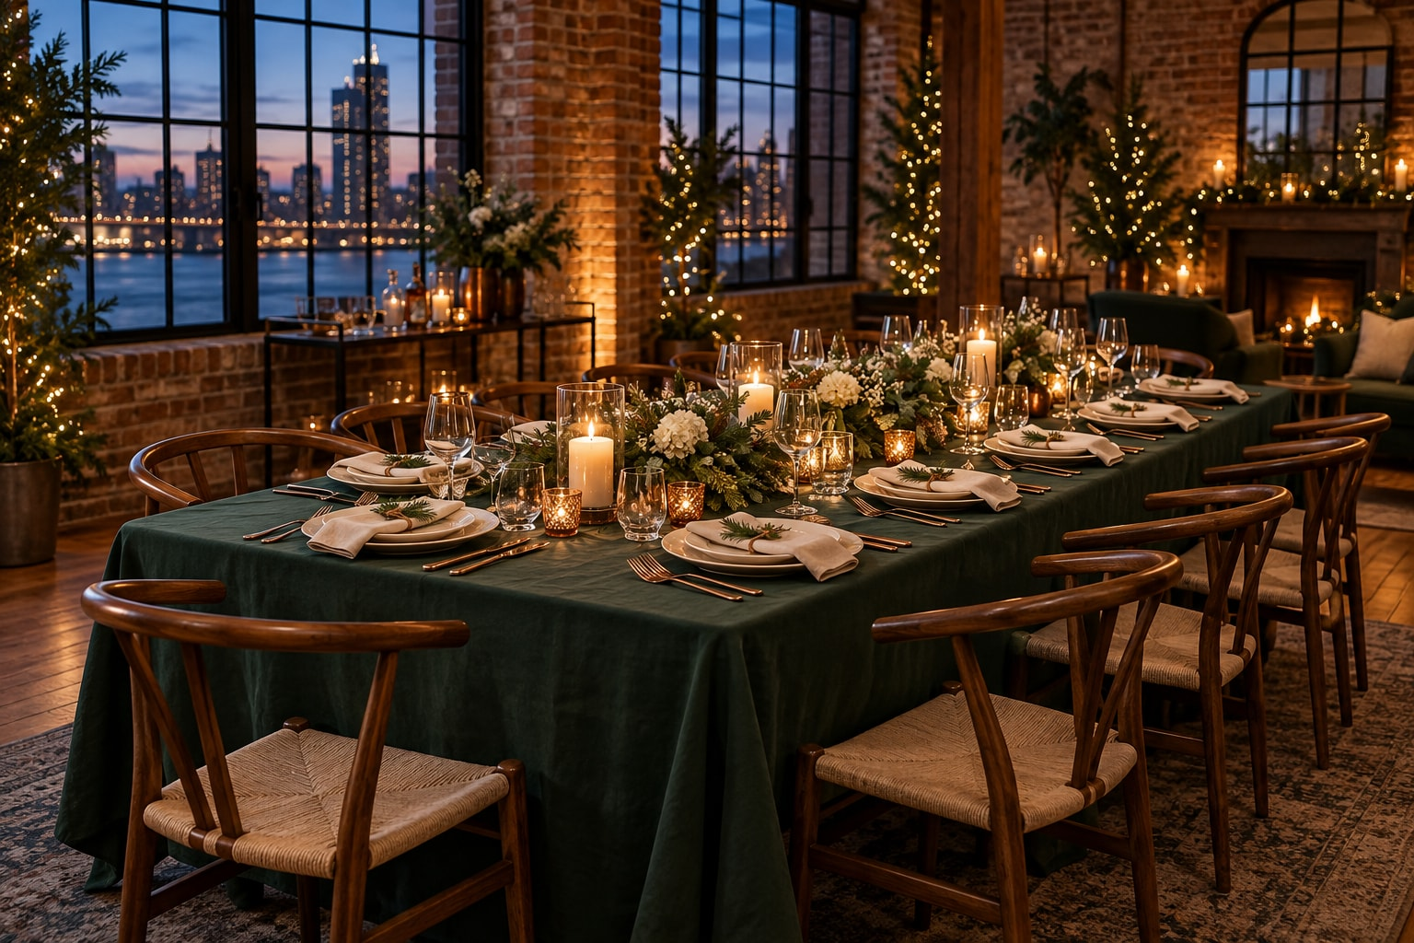
Ascend Global Co.
10
ILLUSTRATIVE SERVICE COMBINATION
A company celebration
Holiday parties and
company milestones
Venue and meal coordination
Seasonal or branded styling
Rental sourcing and logistics
Optional appreciation gifts
Example celebration concept. Choose the elements that suit your team and budget.
Notes:
Illustrative Ascend Global Co. concept. Final products, quantities, styling and services depend on the client brief and confirmed proposal. This concept combines planning, design, rental coordination and optional gifting.
Visual: built-in image generation, not a photograph of a completed Ascend Global Co. project, actual client, confirmed partner, specific inventory item or available venue. Asset: holiday.png.

Slide 11
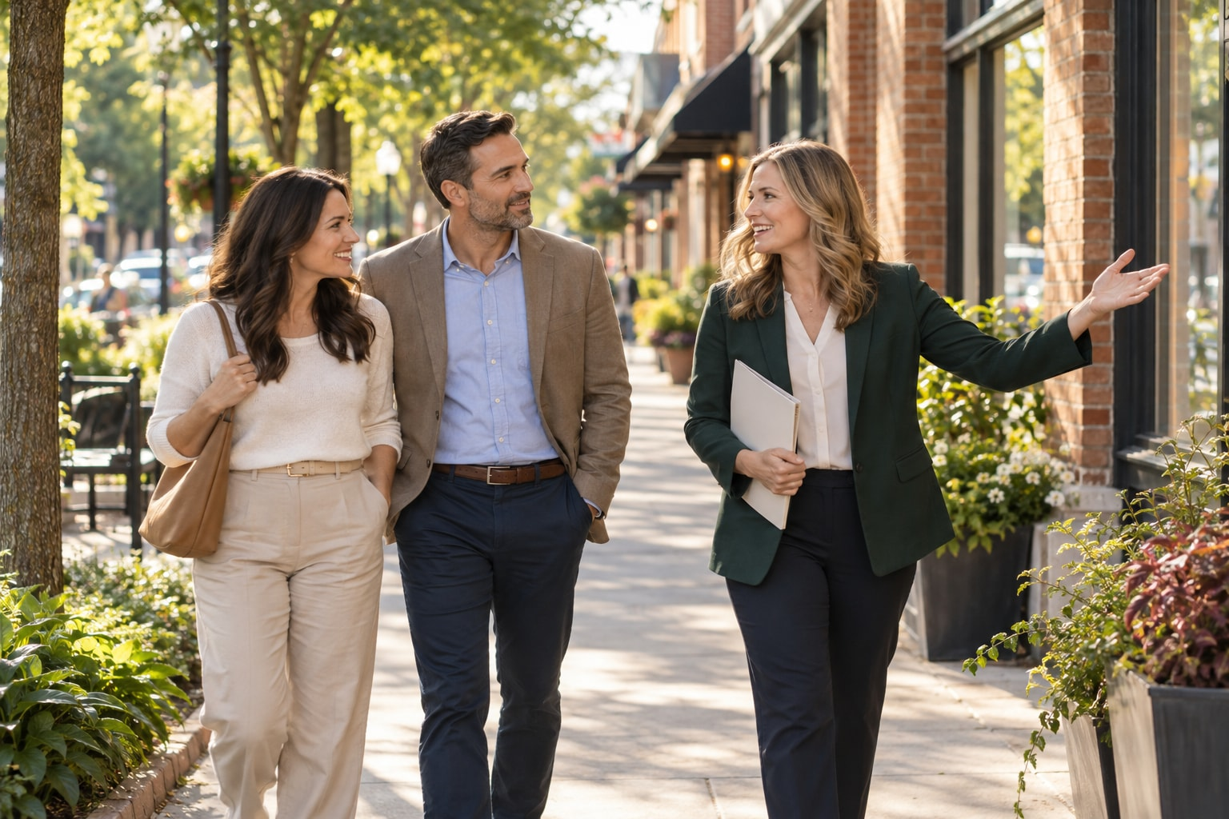
Ascend Global Co.
11
Relocation & settling-in
A thoughtful welcome
to life in the Upstate
Support for employers, individuals
and families moving to the
Greenville–Spartanburg area.
Domestic moves and arrivals
from abroad, tailored to the
needs of each household.
Illustrative relocation concept. International services focus on arrivals to the Upstate.
Notes:
Illustrative Ascend Global Co. concept. Final products, quantities, styling and services depend on the client brief and confirmed proposal. Ascend Global Co. provides orientation and practical settling-in coordination for domestic and international arrivals to the Upstate.
Visual: built-in image generation, not a photograph of a completed Ascend Global Co. project, actual client, confirmed partner, specific inventory item or available venue. Asset: relocation-orientation-concept.png.

Slide 12
Ascend Global Co.
12
Relocation support options
A focused visit, an arrival plan or support through the first weeks.
Discover
the Upstate
Domestic
Settling-In
International
Arrival
Area orientation shaped by
your priorities
Commute and amenity information
Official school resources
Professional introductions
Orientation plus support for
your arrival
Temporary housing coordination
Utilities and local resources
School visit scheduling
Domestic support plus help
navigating everyday processes
Document checklists
Banking and agency appointments
Community orientation
Each proposal defines the support hours, appointments, travel coverage and follow-up period.
Notes:
These are configurable service options, not fixed packages or promises of approval. Area orientation uses client priorities and factual information. School assignment should be confirmed with the district for a specific address. Source: South Carolina School Report Cards, https://screportcards.com/. Real estate professionals handle property showings and transaction-specific services. Source: https://llr.sc.gov/re/News/Showing-Agents-Bulletin.pdf.

Slide 13
Ascend Global Co.
13
International arrival support
An organized plan for unfamiliar appointments and everyday services.
Practical coordination
Professional introductions
Official document checklists
Social Security navigation for eligible applicants
Banking appointments
Driver’s license and vehicle resources
Licensed real estate professionals
Qualified auto and mortgage lenders
Immigration attorneys or
authorized representatives
Ascend Global Co. coordinates practical support. Qualified professionals provide real estate, legal and lending services.
Institutions determine eligibility and approvals. Clients submit sensitive documents directly to those providers.
Notes:
Ascend Global Co. offers administrative navigation and introductions, not immigration strategy, real estate brokerage or lending services. No bank account, Social Security number, loan, visa or other approval is guaranteed. Sources: SSA, Social Security Numbers for Noncitizens, https://www.ssa.gov/pubs/EN-05-10107.pdf. USCIS, authorized immigration help, https://www.uscis.gov/sites/default/files/document/brochures/UPIL_Brochure_English.pdf. South Carolina Real Estate Commission, https://llr.sc.gov/re/News/Showing-Agents-Bulletin.pdf. CFPB SAFE Act guidance, https://www.consumerfinance.gov/rules-policy/regulations/1008/a/.

Slide 14
Ascend Global Co.
14
ILLUSTRATIVE SERVICE COMBINATION
An employee welcome, coordinated
An employer can combine relocation support with a personal welcome at work.
Before arrival
A priorities call, area orientation and introductions to the professionals the household needs.
During the move
An arrival checklist, practical appointment coordination and a welcome gift.
At the workplace
A team welcome lunch, branded essentials and agreed settling-in follow-up.
Notes:
Illustrative example only. This scenario demonstrates how the service lines can combine for an employer-sponsored move. Ascend Global Co. and the client confirm responsibilities and timing in the proposal.

Slide 15
Ascend Global Co.
15
Your project, clearly defined
01
02
03
Your brief
Your proposal
Coordination
Purpose, dates, location,
people or quantities,
priorities and budget.
Scope and support hours,
service fees, provider costs,
timing and responsibilities.
Approved products,
appointments or event details,
with agreed follow-up.
Ongoing employer support can combine new-hire arrivals, recurring gifts and a calendar of team events.
Notes:
Ascend Global Co. can scope individual projects or recurring employer support. Proposals specify scope, support hours, service fees, provider costs, timing and responsibilities. Product minimums, lead times, provider availability and applicable policies vary by project.

Slide 16
Ascend Global Co.
Your next project
An occasion to plan. A person to welcome.
A useful brief includes your goal, preferred dates, location,
number of guests, gifts or relocating households, and budget.
We shape the service proposal around your priorities.
ascendglobalco.com
Serving Greenville, Spartanburg, Simpsonville, Greer,
Woodruff, Pelzer and surrounding Upstate communities.
Notes:
A tailored proposal starts with the project goal, preferred dates, location, quantities or number of relocating households, and budget. Domestic relocation and international arrival support serve the Upstate South Carolina area.
Website: https://ascendglobalco.com/

